Slide 1
Diagonalization of a Symmetric Matrix Using Eigen Decomposition
Tilak Poudel
Roll no. 39

Slide 2
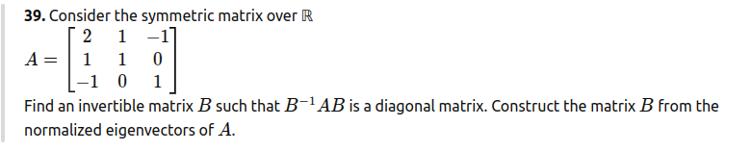
Problem

Slide 3
Objectives
Understand the process of eigen decomposition of a real symmetric matrix.
Derive eigenvalues and eigenvectors.
Construct an orthogonal matrix such that B-1AB = D, where D is diagonal.
Explore applications of eigen decomposition in data science.

Slide 4
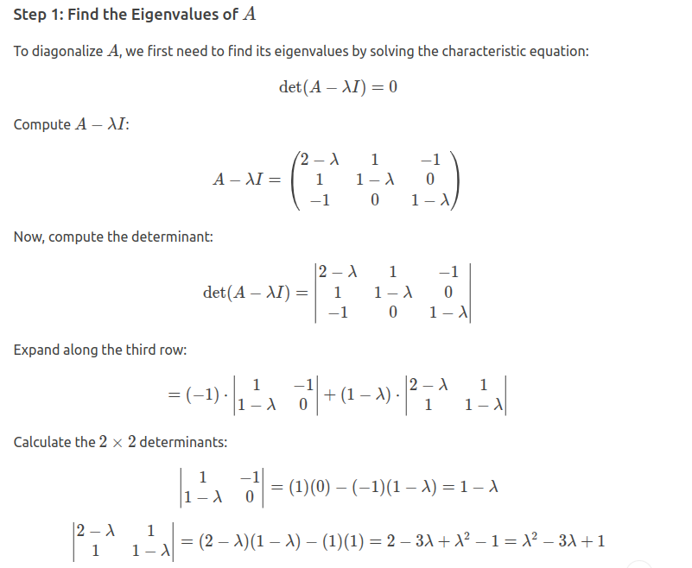

Slide 5
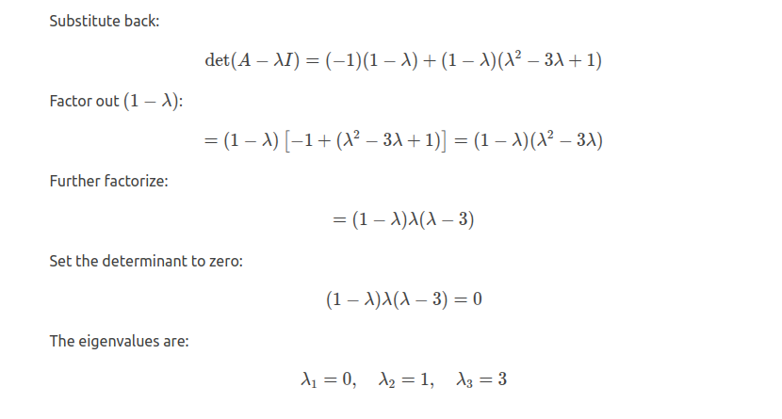

Slide 6
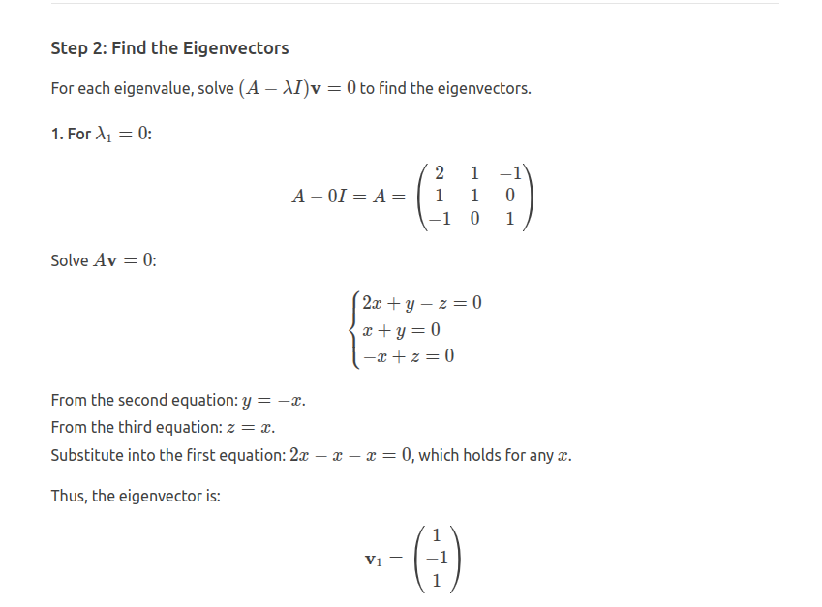

Slide 7
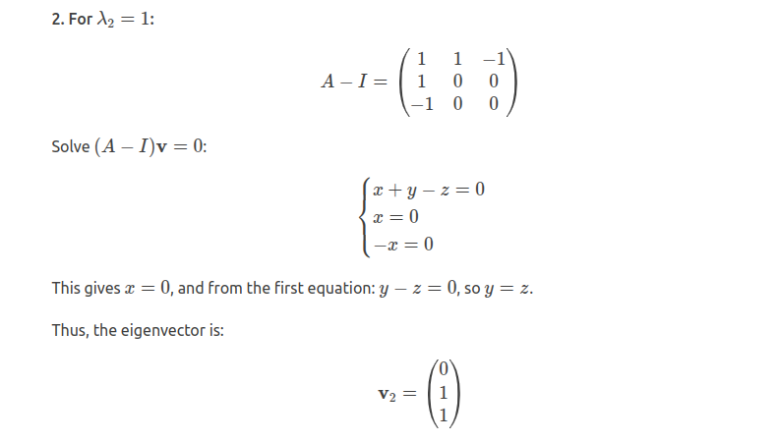

Slide 8
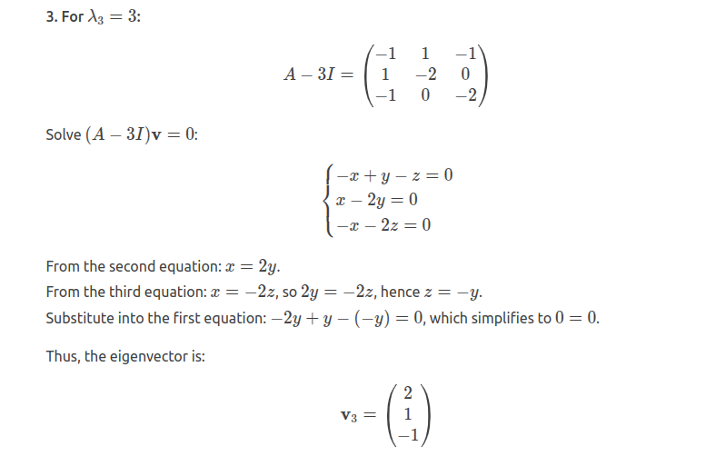

Slide 9
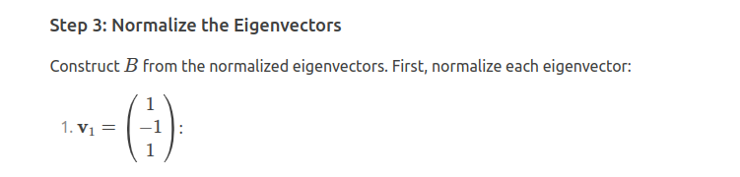
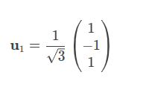
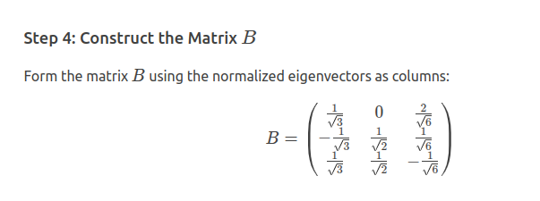
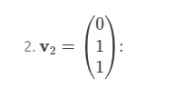
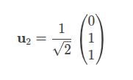


Normalization

Slide 10
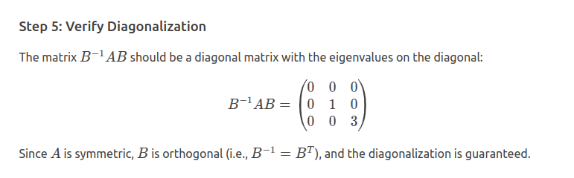
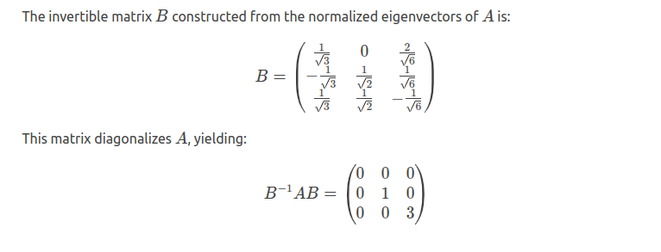

Slide 11
Application
Applications in Data Science
Principal Component Analysis (PCA): Dimensionality reduction using eigenvectors of covariance matrices.
Spectral Clustering: Uses eigenvalues of graph Laplacian matrices.
Recommendation Systems: Latent factor models via singular value decomposition (SVD).
Image Compression: Based on transforming data using eigenbasis.

Slide 12
Thank you

